Slide 1
Understanding Generative AI through Computer Networks
Divya K.

Slide 2
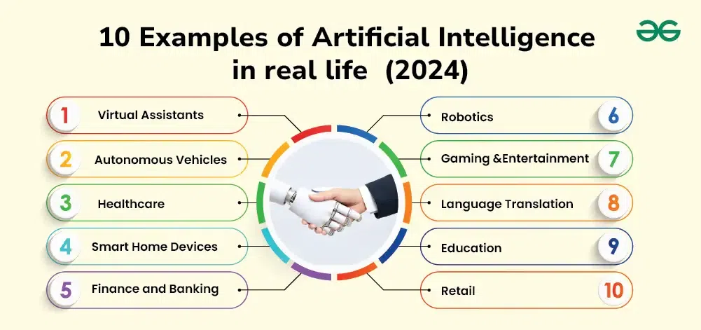
What is AI?
AI is the ability of computers to perform tasks that usually require human intelligence.
Examples: Chatbots, facial recognition, navigation apps.
AI aims to simulate human intelligence through the use of algorithms, data, and computational power.
Types of AI:
Reactive (eg. Basic routing protocols)
Generative (eg. AI designing topologies)

Slide 3

What is Generative AI?
A type of AI that creates new content (text, images, music, code).
Simple analogy: Like a smart artist or storyteller.
Learns from existing data and then creates new data
Mechanism: Uses models like Transformers, GANs
Trained on: Code, images, traffic logs, topology patterns
Output: Novel content like new routing configurations or network security policies.
Notes:
Transformer-
What they are: A deep learning model originally built for understanding and generating text (e.g., used in ChatGPT).
How they work: They look at relationships between all parts of input data at once, instead of step-by-step.
GANs (Generative Adversarial Networks)
What they are: Two neural networks compete — one tries to create fake data (Generator), the other tries to detect fakes (Discriminator).
How they work: Through competition, they improve until the Generator’s outputs are very realistic.

Slide 4
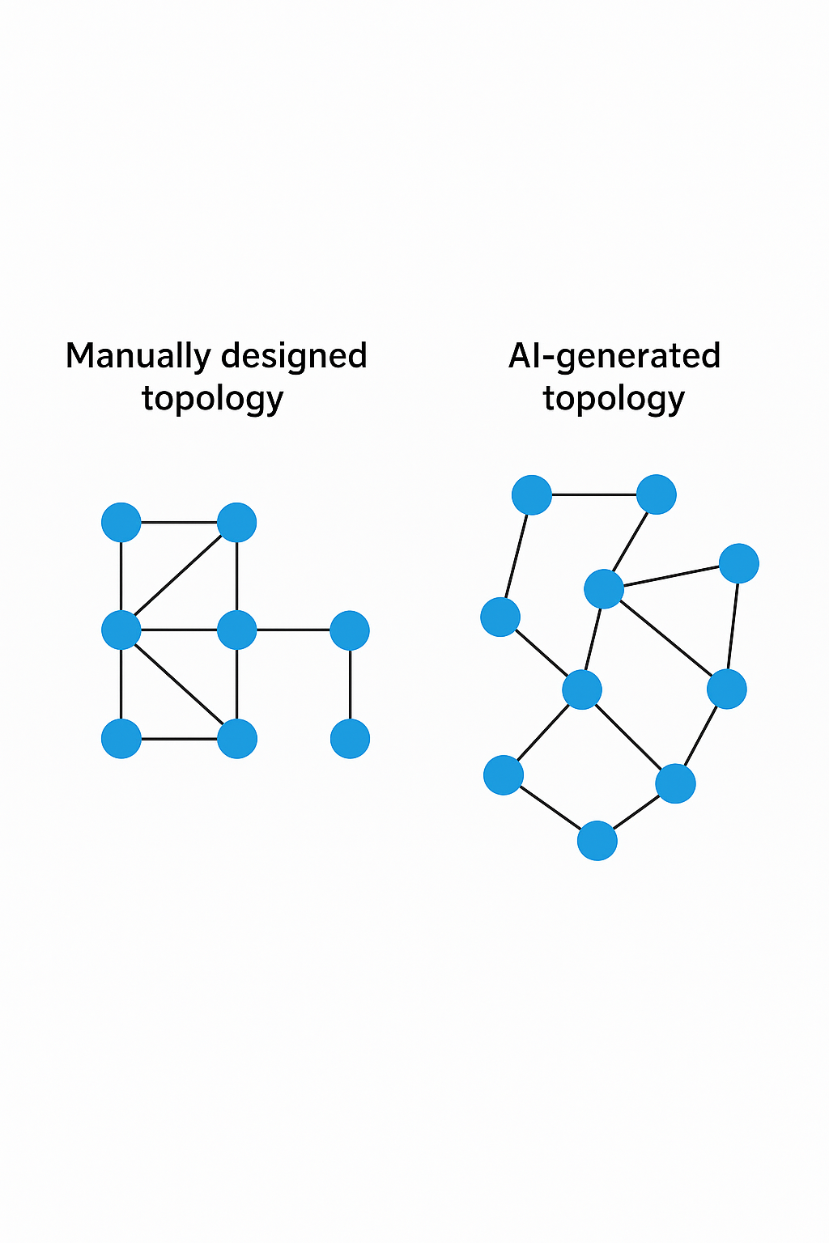
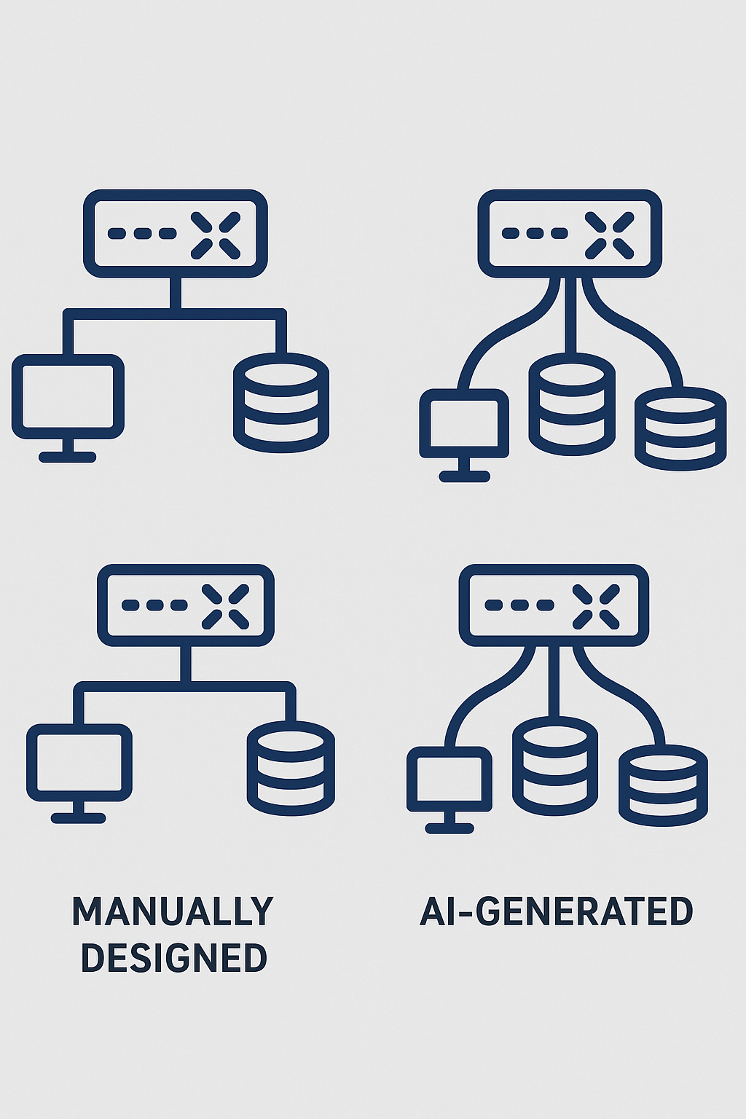
Where Generative AI Meets Networking
Use case: AI-Based Topology Generation.
Problem: Optimal layout for a growing network with cost, delay, and fault-tolerance constraints.
AI Role: Generate network graph (nodes and links) based on constraints.
Tool Example: Graph generation using Transformer models.
Input: Network traffic patterns + QoS constraints
AI Output: Path recommendation policies (eg. AI-generated Shortest path logic)
Comparison: Traditional routing (Dijkstra) vs Generative AI

Slide 5
JOCN - 2025
End-to-end transport network digital twins with cloud-native SDN controllers and generative AI
Abstract:
Use of Network Digital Twins (NDTs) in IP Ethernet networks and optical transport networks by integrating with cloud-native software-defined networking controllers and intent-based networking enabled by generative artificial intelligence (GenAI).
The approach combines advanced virtualization, real-time analytics, and GenAI.
It eliminates manual intervention, minimizes errors, accelerates the deployment of network services, and provides a means for easier network management.
The proposed framework significantly enhances automation, enabling predictive maintenance by identifying potential issues before they impact the network performance.
This collectively improves operational efficiency, reduces downtime, and ensures optimal resource utilization.

Slide 6
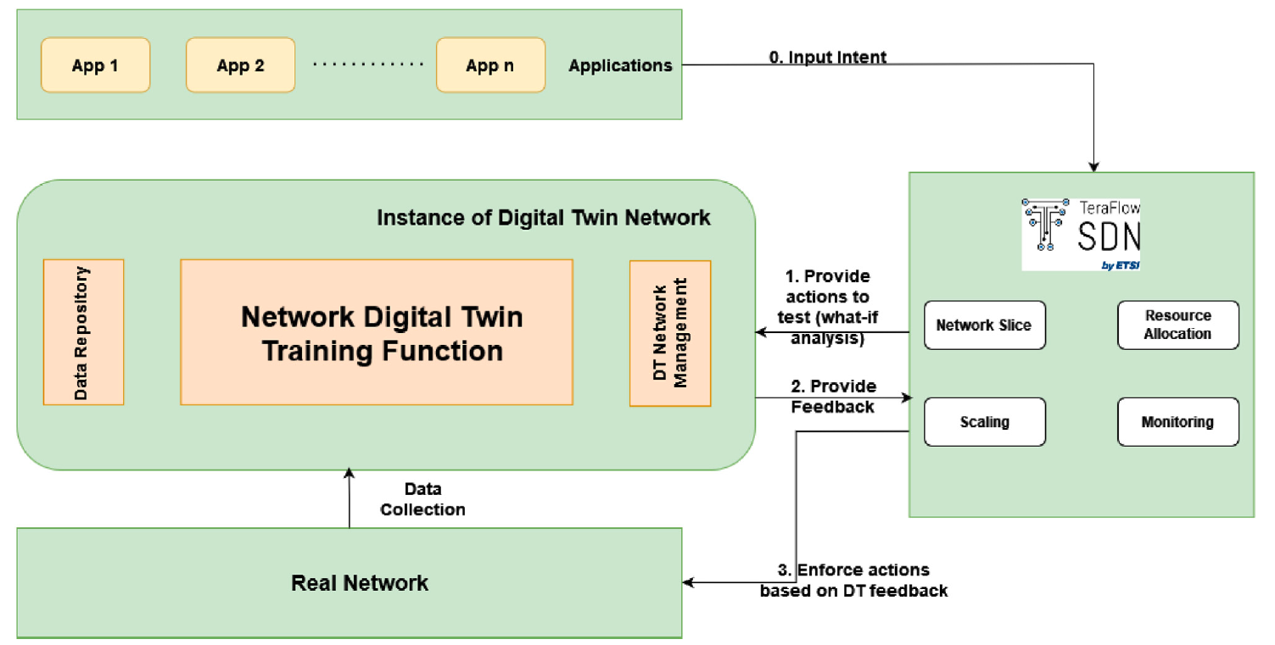
Network Digital Twin for network Operations

Slide 7
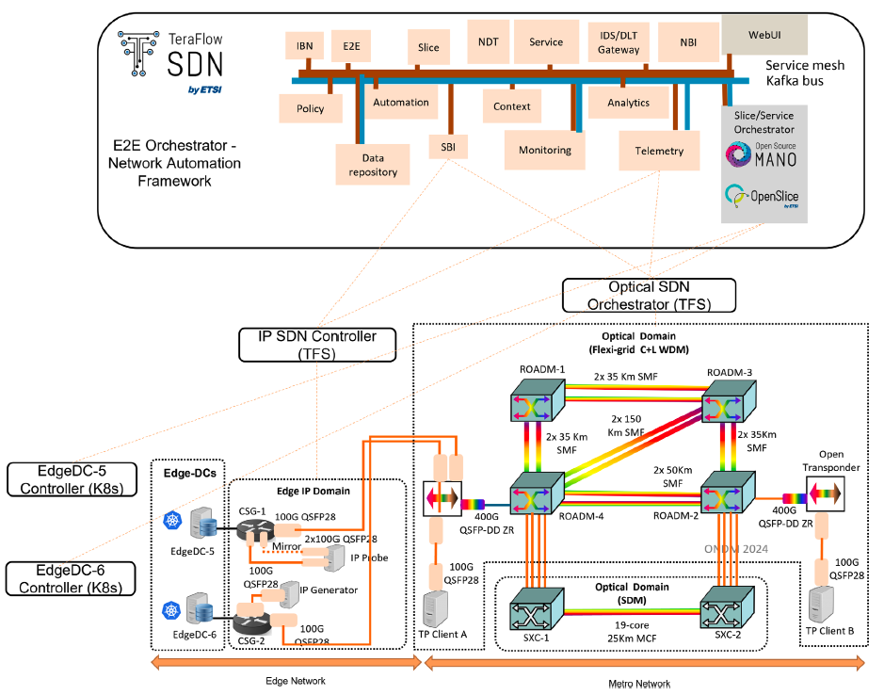
End-to-end Network Digital Twin

Slide 8
Different ways NDT adds value to network infrastructure and operations
Enhanced Design and Performance
Automation of Continuous Monitoring
Traffic Management
Predictive Maintenance
Security
Equipment Management

Slide 9
Digital Twin conponents
Components –
IP SDN Controller – manages IP-based network segments
Telemetry module – real-time network traffic is passed with the help of the telemetry module
SBI – helps the parent SDN controller connect to the child SDN controller to connect to the optical segment of the actual network.
Automation – responsible for the automation of policies, configuration in the network.
IBN module – Translated high-level intents into concrete network policy configurations. It integrates LLMs and natural language processing techniques for the same.
NDT module – Create a virtual replica of the actual network topology, providing a digital environment

Slide 10
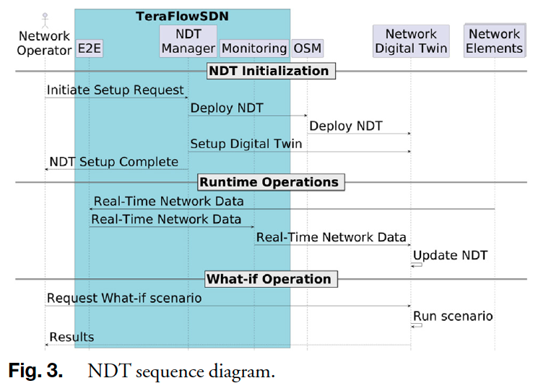
NDT sequence diagram

Slide 11
Intent-based networking and genai
LLMs are used in the IBN to meet the user’s requirement of an abstract request.
Network resource identification, specific policies, and configuration of network devices are delegated to IBN system
Use of LLMs over NLP techniques permits greater automation and flexibility
Intent-based – continuous adjustment in policies and validating real-time network conditions

Slide 12
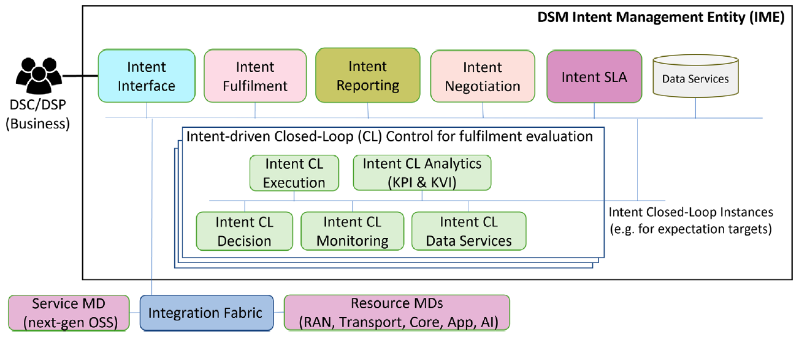
Intent-based architecture: functionalities and components

Slide 13
IBN – integrated with LLM
NDT serves as a crucial platform for implementing IBN systems for efficient network services and resource deployment, and several rounds of adjustments and validations.
LLM processes human-based requests and identifies different items to compose an intent to deliver the final vertical service to the user.
Proposed work –
Chatbot, known as IntentLLM, is integrated with TeraFlowSDN to interpret user prompts and convert them to transport slice requests.
Creation and management of new network slices in real time
Incorporates sophisticated NLP capabilities to help the chatbot understand the context and synonyms for network intents.

Slide 14
Experimental Validation
Containerlab –
50 iterations
2 Nokia SR Linux switches connected to 2 Nokia SR Linux switches
Each switch is connected to the host end-device running on Linux
Mininet-Optical –
Optical network topology consists of 4 ROADMS, connected to optical network terminal
Each optical line terminal is connected to Ethernet link from IP network
Optical line terminal converts fiber-optical signals to digital signals and vice versa

Slide 15
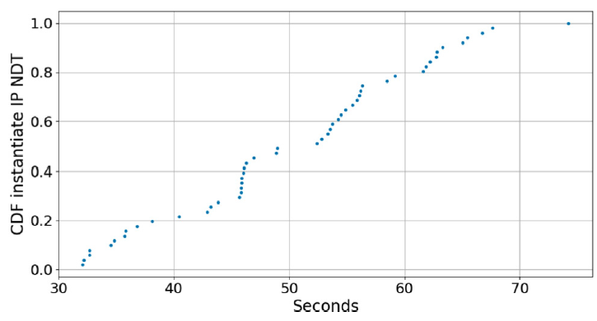
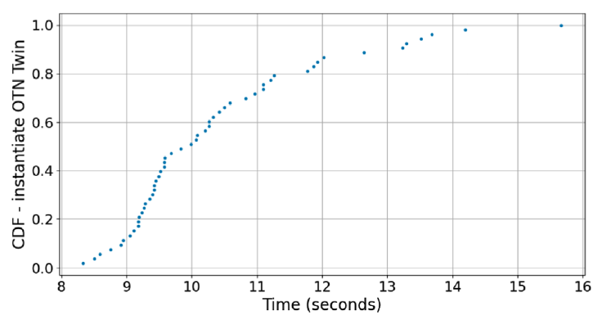
Experimental Validation
Time taken to instantiate an IP network digital twin on ContainerLab
Time taken to instantiate a transport network twin on Mininet-Optical

Slide 16
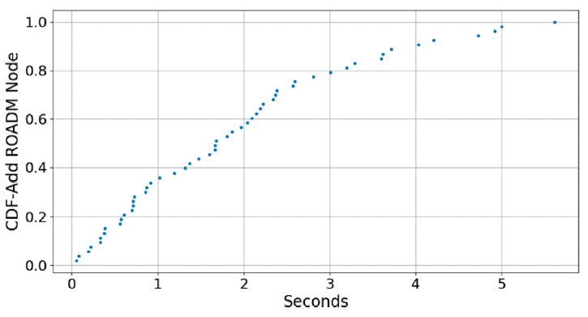
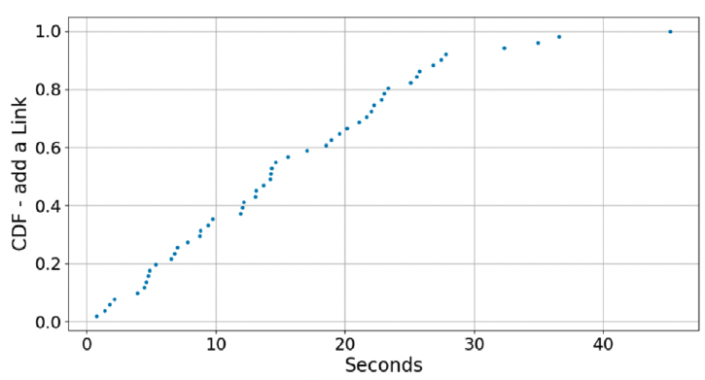
Experimental Validation
Time taken to add a ROADM to the optical network twin
Time taken to add an Ethernet link to IP NDT

Slide 17
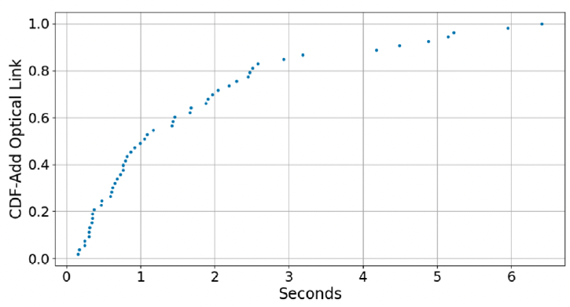
Experimental Validation
Time taken to add an optical link to the optical transport NDT

Slide 18
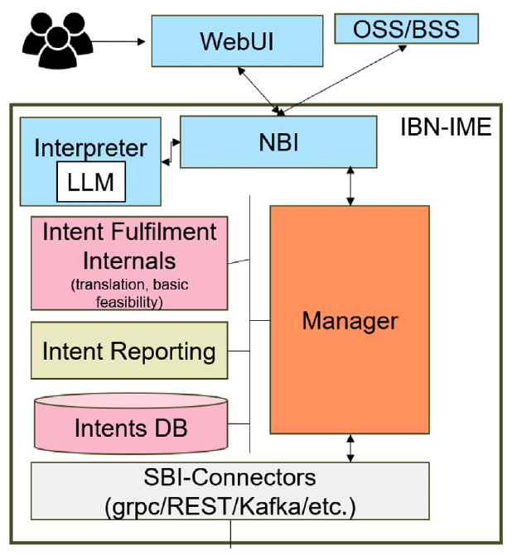
Experimental Validation
Validation of the IBN Architecture –
User request via WebUI interface
NBI filters received requests
Interpreter has 2 processes –
Extract relevant information and identify the specified KPI and their corresponding values
Generate intent JSON objects according to the extracted KPI
Main components of the IBN implementation

Slide 19
Experimental Validation
Validation of the IBN Architecture (example) –
Intent request – provide a connectivity service between node A port X and node B port Y of QoS gold and BW one T
Interpreter identifies the main KPI - { source: A, sourcePort: X, destination: B, destinationPort: B, QoT: gold, bandwidth: 1T, }
KPI – location attributes, including port, source, destination; time restrictions, indicating specific dates or durability restrictions; bandwidth restrictions.
Intent forwarded to manager, to communicate to the rest of components
Interpreter powered with LLM model – Llama 3 8B

Slide 20
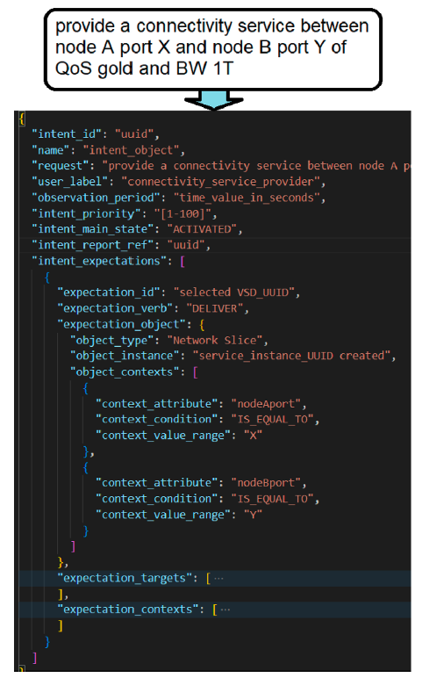
Experimental Validation
Sample case of a constructed intent in the figure

Slide 21
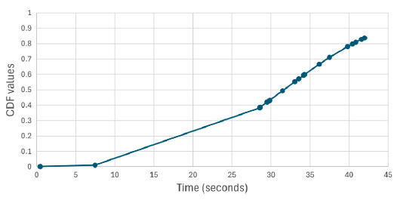
Experimental Validation
CDF values for the amount of time taken to construct and trigger the intent request in the network

